Slide 1
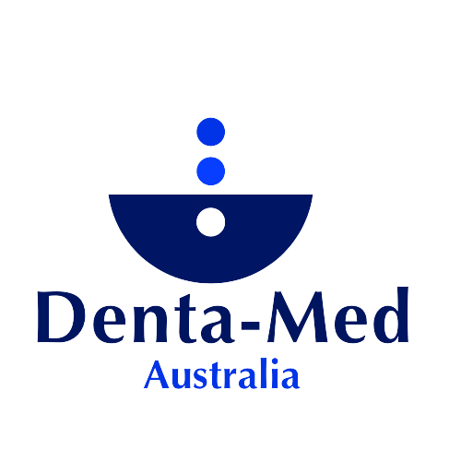
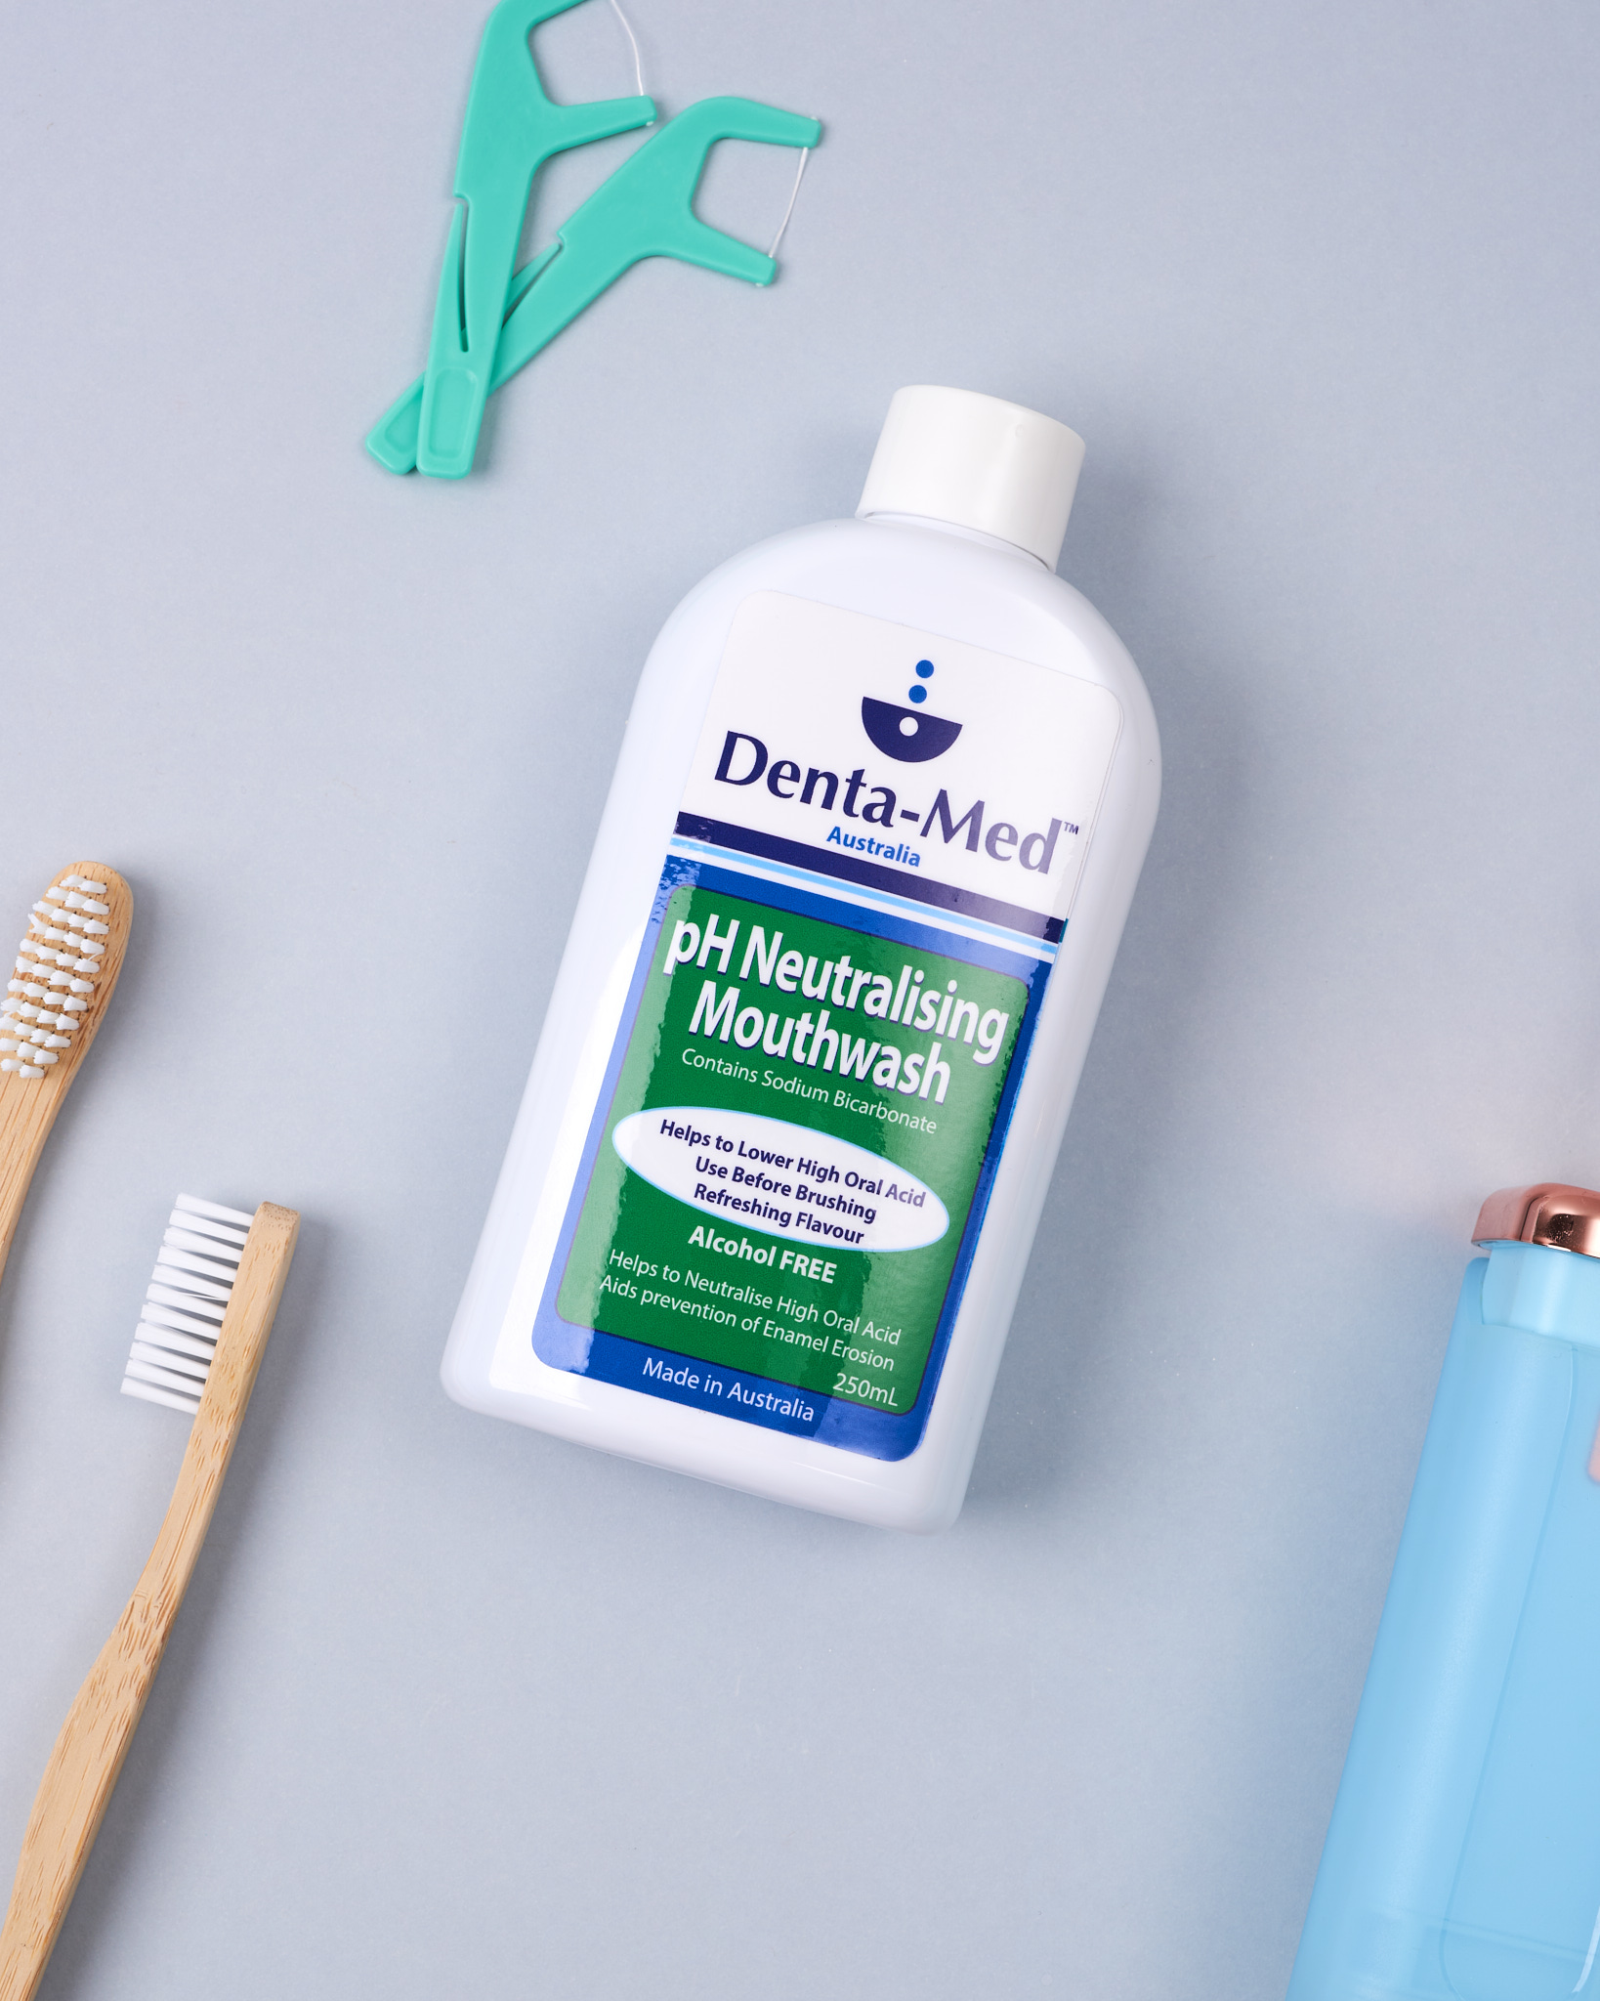
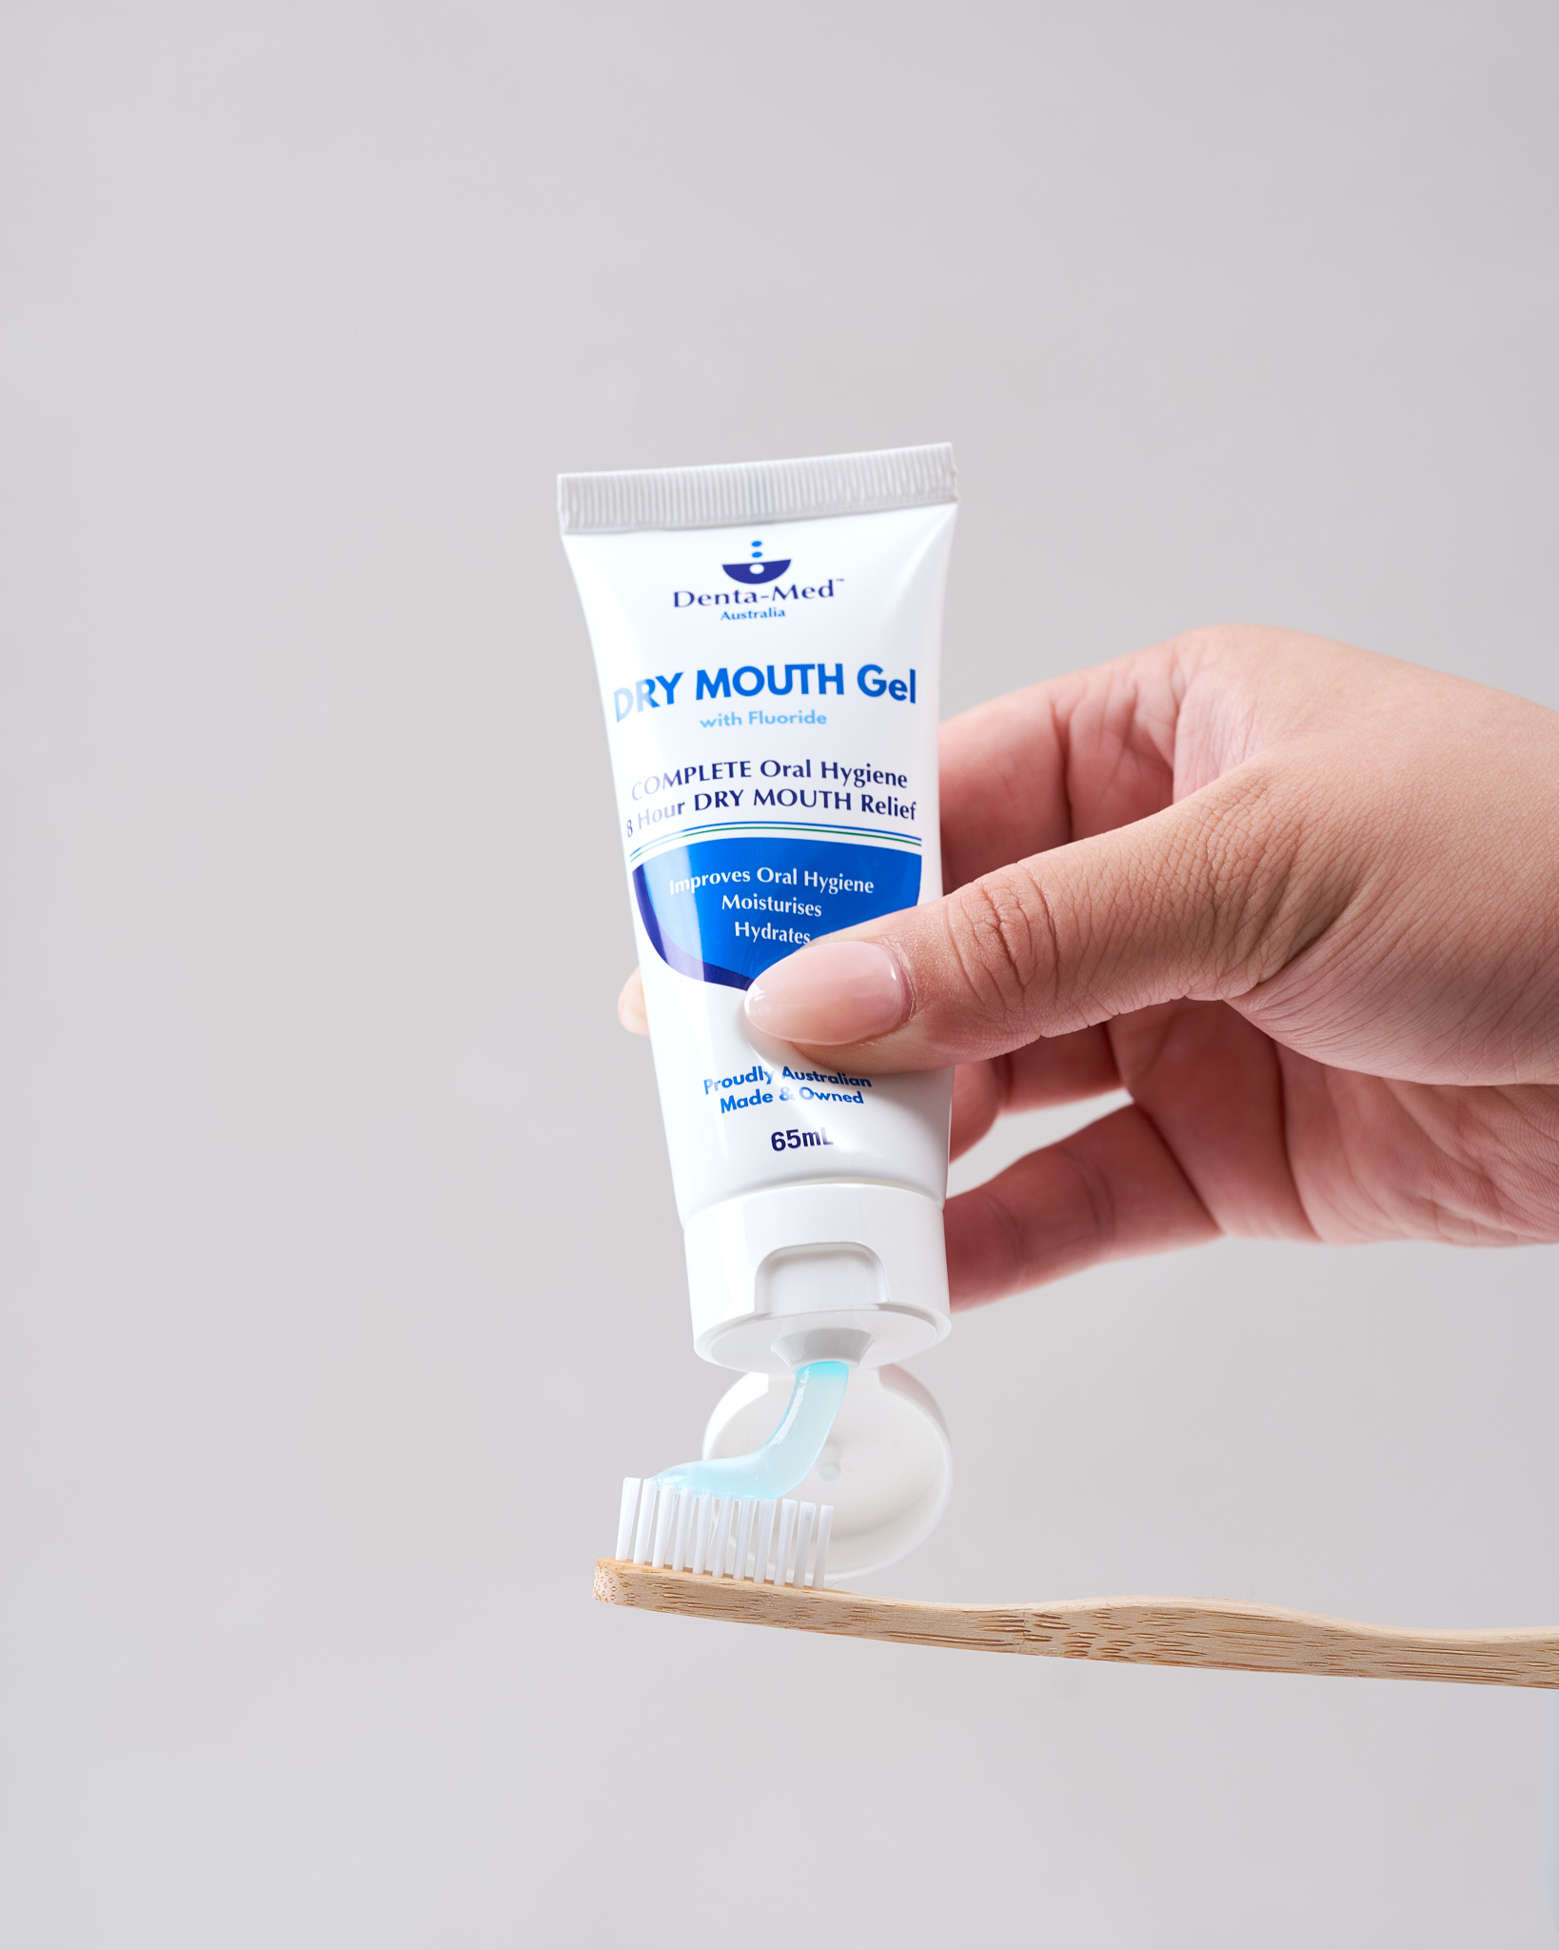
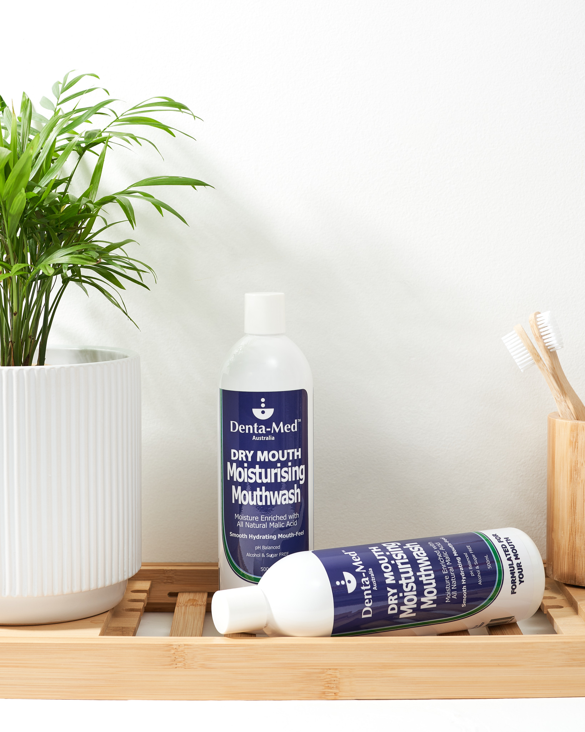
Directions for use in situations of Acid Reflux / pH enamel erosion
Rinse
1
2
3
Rinse with 1 - 2 caps of Denta-Med pH Neutralising Mouthwash BEFORE brushing teeth or flossing
Buffering pH, preparing the mouths pH to as close to neutral as possible
Brush teeth with Denta-Med Dry Mouth Gel for 2 minutes.
Brushing for 2 minutes to allow the Sodium Fluoride 1,000ppm to uptake. Denta-Med Dry Mouth Gel formulation also contains Zinc Chloride, CPC, Prop. Chitin
Toothpaste containing both fluoride and zinc has been proven to be more effective in preventing dentine demineralization and promoting remineralization, when compared to those containing fluoride alone
(Ref; Zinc: A precious trace element for oral health care?Fatima T, Haji Abdul Rahim ZB, Lin CW, Qamar Z J Pak Med Assoc. 2016 Aug; 66(8):1019-23.)
Rinse with 1 - 2 caps of Denta-Med Moisturising Mouthwash after brushing teeth or as required throughout the day
Enriched with all-natural Malic Acid, Prop. Chitin, hint of lemon myrtle

Slide 2
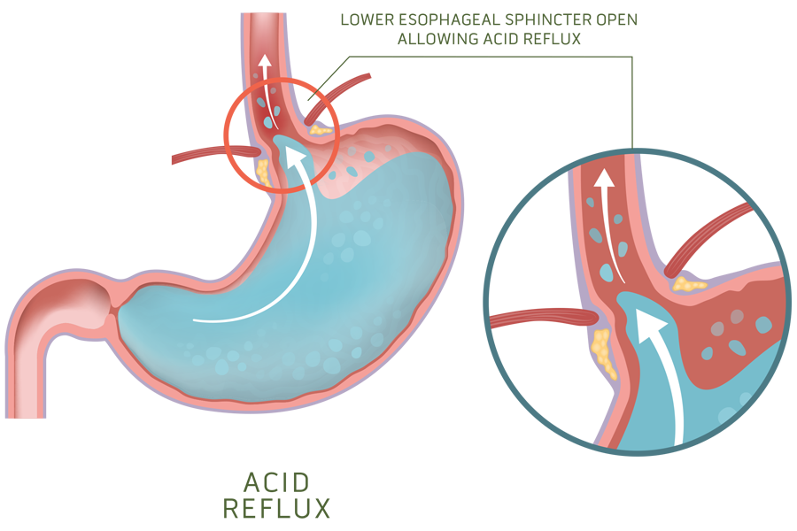
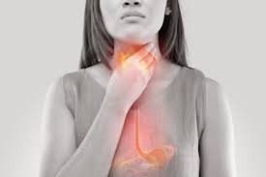
Oral pH & Saliva
Your salivary pH can have serious implications for your dental health. While tooth enamel is the hardest substance in the body, it can be damaged by acidic saliva. When the pH of your saliva drops below 5.5, your tooth enamel starts to break down.
Tooth Enamel can’t grow back the damage is permanent. If acids have eroded your enamel, your teeth might be sensitive. You could also notice discomfort when you drink hot, cold, or sweet beverages. A yellowish discoloration is another warning sign of enamel erosion.GORD/GERD (gastroesophageal reflux disease) can cause acidity in the oral cavity
The stomach’s primary gastric acid is hydrochloric acid
Stomach acid is able to dissolve metal
Acidic food/beverage also contribute to lower oral pH
High acid intake, and low saliva flow places the teeth and mouth at very high risk
Denta-Med pH Neutralising Mouthwash helps to buffer the mouth’s oral balance
Denta-Med Dry Mouth Gel protects teeth / oral mucosa with ingredients known to provide antibacterial, antifungal and anti-inflammatory benefits – for up to 8 hours
Denta-Med is Endorsed by Australia’s leading Comprehensive Cancer Centre, Peter Mac VCCC – Dental Oncology Unit
References: , Evans DF, Smith BG. The relationship between gastro-oesophageal reflux disease and dental erosion. J Oral Rehabil. 1996 May;23(5):289-97. doi: 10.1111/j.1365-2842.1996.tb00855.x. PMID: 8736440

Slide 3
Denta-Med™ pH Neutralising mouthwash
Denta-Med pH Neutralising Mouthwash enriched with Sodium Bicarbonate 250mL bottle. Sodium Bicarbonate is well known to help reduce harmful high oral acid levels in the mouth
Oral pH will increase markedly when consuming fizzy drinks (including sugar-free), sports/energy drinks, citrus fruits, Kombucha, vitamin C tablets, lemon-flavoured drinks or tea, vinegar, wine or pre-mixed alcoholic drinks
Stomach acid is highly acidic and dentally harmful, causing erosion of tooth enamel. This can lead to substantial dental treatment being required, from fillings through to root canal treatment (if left unchecked)
Stomach acid may reach the mouth via vomiting and reflux. Some people are more at risk if suffering from morning sickness, anorexia or bulimia and heartburn
Denta-Med™ pH Neutralising Mouthwash has a welcome refreshing flavour, eliminating the unpleasant taste of home-made ‘sodi-bicarb’ mouthwash
Best results are achieved by rinsing the mouth with Denta-Med™ pH Neutralising Mouthwash before brushing teeth. Rinse/gargle as frequently as required after consumption of products high in acid
References: , Evans DF, Smith BG. The relationship between gastro-oesophageal reflux disease and dental erosion. J Oral Rehabil. 1996 May;23(5):289-97. doi: 10.1111/j.1365-2842.1996.tb00855.x. PMID: 8736440

Slide 4
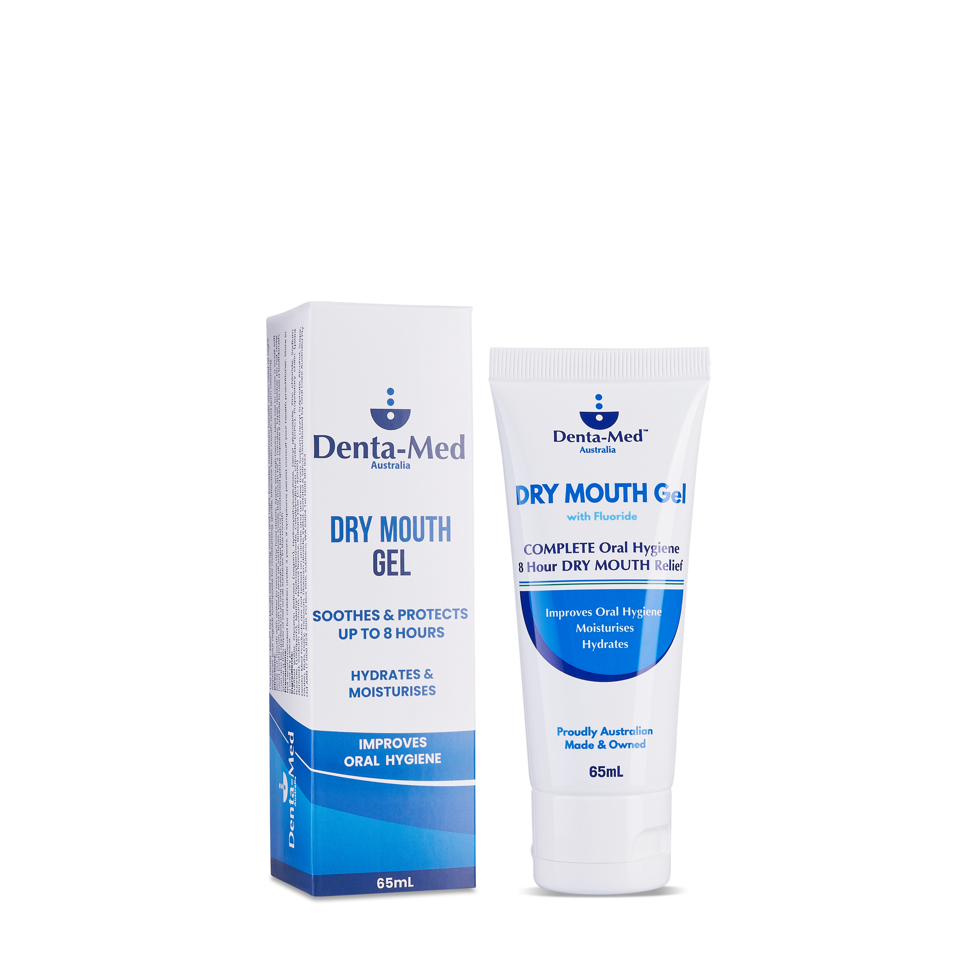
Denta-Med™ DRY MOUTH ORAL HYGIENE Gel
Denta-Med Dry Mouth Oral Hygiene Gel 65mL Tube
Provides 8 hour (overnight) relief from Dry Mouth
Denta-Med™ is a moisturising, fluoridated gel (Sodium Fluoride 1,000ppm) binding to the surfaces inside the mouth
Brush with Denta-Med™ Dry Mouth Gel instead of regular toothpaste for dry and sensitive mouths
Proprietary ingredients in Denta-Med™ provide multiple benefits – cleans, protects, moisturises, hydrates and soothes the mouth and nurtures oral mucosa and the gingival tissue
Denta-Med™ enhances the quality of saliva. Where there is no saliva present, Denta-Med™ Dry Mouth Gel replaces/replicates its very important protective role in the mouth
Denta-Med™ Dry Mouth Gel is a long lasting, hydrating formulation. Using gentle cleansers that are low foaming (no SLS), alcohol free, does not dry, sting or burn the mouth
Made in Australia (Available in 65mL Tube, 125mL Pump Bottle, 300mL Pump Bottle and box of 20 x 3mL individual sachets)
Brush teeth with Denta-Med Dry Mouth Gel for 2 minutes.
Brushing for 2 minutes to allow the Sodium Fluoride 1,000ppm to uptake. Denta-Med Dry Mouth Gel formulation also contains Zinc Chloride, CPC, Prop. Chitin
Toothpaste containing both fluoride and zinc has been proven to be more effective in preventing dentine demineralization and promoting remineralization, when compared to those containing fluoride alone (Ref; Zinc: A precious trace element for oral health care?Fatima T, Haji Abdul Rahim ZB, Lin CW, Qamar Z J Pak Med Assoc. 2016 Aug; 66(8):1019-23.)
ENDORSED BY PETER MAC DENTAL ONCOLOGY UNIT AS THE PREFERRED DENTAL HYGIENE AGENT -
FOR BOTH PREVENTATIVE & SYMPTOMATIC RELIEF

Slide 5
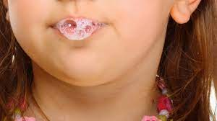
Dry Mouth
SALIVA
Saliva quality is important
During the day, our saliva glands work very hard
They produce between one and two litres of saliva every day
Saliva glands rest at night = dry mouth overnight
Medical conditions and medications can impair salivary flow
Histatin, a protein in saliva can accelerate healing
Opiorphin, a potent natural pain killing substance, is also present in saliva
Opiorphin is reported to display a painkilling effect six times greater than that of morphine
Healthy saliva buffers the oral pH
Dry Mouth dangerously decreases the oral pH
Dry Mouth increases plaque development & caries

Slide 6
Moist Mouth
With Denta-Med™
Cleans, protects, moisturises & hydrates up to 8 hours
Muco-adhesive formulation
Fluoridated / toothpaste replacement / low foaming
Relieves Dry Mouth when no saliva is present / replicates / replaces the action of saliva
Freshens breath / reduces mouth odour
Long lasting moisturising effect
Benign flavour – does not burn or irritate / pH balanced
Does not contain Sodium Lauryl Sulphate, alcohol, xylitol
Water soluble / safe to use ongoing
Does not contain nuts, gluten, dairy, sugar, egg
Made in Australia / Never tested on animals / Vegan
Formulated For Your Mouth
$$™$$

Slide 7
Medications With Potential Reflux Side Effects
Thyroxine
Statins (HBP)
Contraceptive Pill
Antibiotics, such as tetracycline and clindamycin
Bisphosphonates taken orally, such as alendronate (Fosamax), ibandronate (Boniva) and risedronate (Actonel, Atelvia)
Iron supplements
Quinidine
Pain relievers, such as ibuprofen (Advil, Motrin IB, others) and aspirin
Oesteo panadol
Potassium supplements
Anticholinergics
Tricyclic antidepressants
Calcium channel blockers, statins, angiotensin-converting enzyme (ACE) inhibitors and nitrates used for high blood pressure and heart disease
Narcotics (opioids), such as codeine, and those containing hydrocodone and acetaminophen
Progesterone
Sedatives or tranquilizers, including benzodiazepines such as diazepam (Valium) and temazepam
Theophylline

Slide 8
KEY INGREDIENTS
Zinc Chloride
Has anti-inflammatory properties and is an essential trace element for maintaining good oral health
Zinc is known to help reduce the incidence of aphthous ulcers, plaque build-up and bad breath (halitosis)
Cetylpyridinium Chloride (CPC)
Has anti-bacterial and anti-microbial benefits. CPC is reported to improve gingival (gum) health. CPC was first described as having clinical effect in 1962. Both Anti-plaque (can be removed by brushing) and anti-calculus (also known as tartar, hardened plaque that cannot be brushed away)
Proprietary Chitin (plant derived) Denta-Med’s proprietary ingredient
Is a naturally occurring polysaccharide. Chitin has wound healing properties, stimulating the recovery of damaged epithelial (mouth) cells (common in people using respiratory inhalers) Chitin has anti-inflammatory and film forming (binding) properties
Sodium Fluoride
Is a natural mineral. Fluoride is also present in some food and drinks (fish & tea) Fluoride reduces the amount of acid that bacteria leave on your teeth, Fluoride is also proven to strengthen tooth enamel. This is very important. As enamel is weakened, small holes in your teeth (cavities or dental caries) can form
(Additional Information)
Toothpaste containing both fluoride and zinc has been proven to be more effective in preventing dentine demineralization and promoting remineralization, when compared to those containing fluoride alone (Ref; Zinc: A precious trace element for oral health care?Fatima T, Haji Abdul Rahim ZB, Lin CW, Qamar Z J Pak Med Assoc. 2016 Aug; 66(8):1019-23.)

Slide 9
Denta-Med™ Suitability in aged care
Ingredients contained in Denta-Med protect the resident’s mouth from a high bacterial load
Clean, soothe, calm and moisturise the mouth, thereby improving Quality of Life
Denta-Med Gel is water soluble. Denta-Med Gel does not build up in the resident’s mouth or throat and pose as a potential choking hazard.
Denta-Med viscosity ensures it is safe for all levels of IDDS fluids.
Do not contain any irritants (strong mint flavours), Sodium Lauryl Sulphate (foaming & drying agent), Alcohol (can burn, sting and dry) or abrasives.
Denta-Med products are pH balanced, nut, gluten, alcohol, dairy, sugar, egg free and never tested on animals.
Denta-Med products are suitable for the diabetic community.
Denta-Med is 100% Australian Made and Family Owned

Slide 10
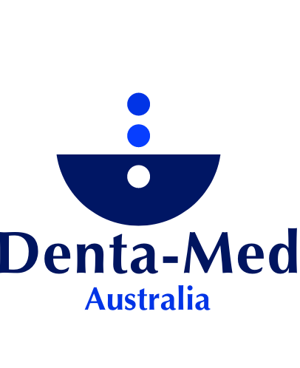
I suffer from Sjogren’s with dry mouth. Before I started using Denta-Med my mouth had ulcers and I would wake up with the worst dry mouth. JC, NSW
“Their mouths are comfortable, clean and moist” MV, Secretary of Lupus Scleroderma Sjogrens SA Support Group
“…approximately 92% of residents are in the category of moderate to severe dementia. Conventional mouth care is often not possible when dealing with residents with aggressive and unpredictable behaviour. Denta-Med Gel has been used for 3 years in this home. Audits have revealed that (the Gel) has been effective in maintaining a very satisfactory oral health standard (and) in many cases markedly improved the oral health status of our residents” DoN, FBNH, WA
“… the only thing that helped my sore tongue” JW, Vic
…damage to taste buds and saliva glands, causing me to suffer for 7 years with persistent and painful ulcers to the mouth cheeks and tongue. Mouth wash 4 times a day, gum shields with fluoride gel, artificial saliva sprays and various liquids and lozenges failed to make any impression on these ulcers…a sample of Denta-Med Gel… Lo and behold within a week almost every ulcer had disappeared, and my dry mouth was no longer a problem. It remained moist, not wet and I was able to enjoy undisturbed sleep for the first time in years. JSM, WA
Testimonials
“I use it before going to bed and Wow! The next morning no more morning breath… the white film on my tongue is markedly reduced. My gums no longer bleed” SN, ACT
“ no matter how much I brushed and flossed … he still said I had bad breath. Denta-Med Gel has saved my social life.
“I got metatastic melanoma around the lymph glands in my neck…my tongue is overly sensitive and prickly, my mouth gets yucky and my whole mouth condition (despite following every single rule I have been given – bicarb mouth washes, [brand deleted], fluoride trays etc. etc.) is very poor. My post cancer dentist gave me some Denta-Med Gel, a year ago and OMG this has made such a difference. Denta-Med Gel has been a life saver to my sleep.” N.L, NSW
“I know it sounds corny, but Denta-Med Gel has made such a difference to my quality of life. My teeth feel better, my tongue hurts less, my breath isn’t stinky, and I can sleep.”
“I can’t remember the last time I had an ulcer, and it protected my gums through my last two pregnancies…when gums soften with an increased level of hormones.” ED, Vic
I had huge problems with sensitivity in my mouth following radiation treatment. This is now resolved using your oral gel. After applying the Denta-Med gel, I was amazed at the almost immediate benefit. AM. B, WA

Slide 11
“As I stated; my husband has been undergoing Chemotherapy for the past 23 months and had 30 Rx. of Radiotherapy combined with 10 Rx. of Chemotherapy last Feb. –March 2015. Then He was given different Chemotherapy (NIVOLUMAB)in the Nov. 2015 and became aware his mouth was very dry, no saliva, not able to talk properly, taste or smell food and a very coated tongue. The coating on his tongue was about 5mm thick and what ever was taken orally in the form of fluids the tongue took on the colour of the fluid eg. (Coffee –black, Red Wine –a dark red, Protein Drinks –yellow discolouration) nothing would shift this thick coating. Scrubbing with a toothbrush, N/Saline mouth washed, and Sodium Bicarbonate Mouth Washes had little effect in cleaning the tongue or assisting the production of saliva. Some Nursing staff claimed it was Oral Thrush and ordered (brand name deleted) oral drops, this had no effect on the thick coating of his tongue. I disputed this diagnosis as there was no tongue or mouth soreness on hot drinks or when eating food.
He tried (brand name deleted) many mouth washes, gels and sprays these had no effect, his mouth was totally dry even when he used the (products) repeatedly during the day. A bottle of water created more moisture in his mouth while drinking. At my wits end, I inadvertently (and fortunately) came across Denta-Med Gel. My husband’s ongoing oral issues were resolved by using Denta-Med. His mouth is moist and comfortable, he also reports an improvement with the salivary quality and content of his mouth. Anon.
While my husband was undergoing Radiotherapy Rx. again, at Epworth Hospital in August 12- 18th 2016, one of the Radio-oncology Nurses gave him 4 x 5ml sachets of Denta-Med to try. In 6 days, he had noticed his tongue was less coated and he had some moisture in his mouth. He is using the Denta-Med daily BD. It is now 16 days since he started using the Denta-Med and his tongue is almost totally clean and pink and he has saliva back in his mouth. He still has days when his speech is not clear, but these are less frequent. The vast number of Chemotherapy drugs he has been given in the past 23 months has had a detrimental effect on his body and appetite, but he no longer has to apologise to the Dentist for the “dry black tongue”. I would recommend Denta-Med to any person undergoing Chemotherapy, for the protection of their tooth enamel and oral hygiene in general, especially if suffering from the “dry mouth syndrome”. Diana. Rosanna, Victoria
Your Mouth Gel is by far superior to any other I’ve tried, and there’s been many, which are horribly sweet with artificial ingredients or burn my mouth. It’s disgusting and torture having to use them which I unfortunately must because of mouth ulcers, gum disease and bone loss due to many medicines from the age of 10. I’m now 69 and to find your product is such a relief because it’s gentle, pleasant, comforting and does the job better than any other. It’s also an actual pleasure to use which I do more often than I’ve ever done and, to make it even better, is the fact it’s Australian made and owned which I’m delighted with because I try to buy only products and food that are." Yours sincerely, Denise Forsyth, ACT
Testimonials
Just thought I'd send an email to thank you for making a terrific product. While my wife was very ill and undergoing heavy doses of chemotherapy, we were introduced to Denta Med Gel. It was the only toothpaste/gel she could use that didn't adversely react with her treatment. To finally find a product that would allow her to clean her teeth and freshen up her mouth without any side affects or harsh metallic aftertaste was a great comfort to her. Terry Downey, Vic
[Resident] refused to open her mouth for oral care, we used to put a little Gel on a spoon and offer it to her. She had a habit of rolling food around in her mouth & this she did with the Gel. A few weeks later she allowed us to clean her mouth with some Gel on gauze and a few weeks after that we were able to use a soft toothbrush…she changed from being an angry, worried looking lady to being a happy person w ho laughed readily. I felt that this was one of our major achievements in oral care.“ FM, WA
”...a lady having treatment for breast cancer with severe intractable mucositis with no relief from standard products available. She is now ulcer free and stated she felt relief within hours of starting Denta-Med Gel, and within 2 days her ulcers had improved significantly.” ANUM, Yarra Ranges Health Day Oncology, Vic
“...I wasn’t sure what to expect from Denta-Med. I used it for the first time and cried with relief that it brought, instantly calming and no stinging whatsoever!” J. Turnball, Vic

